Slide 1

Web Controls

Slide 2
Content
The Page Class
Fundamental Web Controls
Sending User to a New Page
The Anatomy of ASP.NET Pages
Anadolu University

Slide 3
Page Class
Every web page are inherited from System.Web.UI.Page class
By inheriting Page class, you can use a number of properties and methods
Anadolu University

Slide 4
Page Class
Property | Description
IsPostBack | Returns true if the page is submitted back, and false if the page is loaded for the first time
Request | Contains information about the current web request
Response | Represents the response that ASP.NET will send to the user’s browser
EnableViewState | Represents whether the controls in the web page maintain their state information
Server | Allows you to perform a few miscellaneous tasks
Anadolu University

Slide 5
Page Class
Property | Description
Application | Holds information that’s shared between all users in the website
Session | Holds information for a single user
Cache | Allows you to store objects that are time-consuming to create so they can be reused in other pages or for other clients
User | If the user has been authenticated, this property will be initialized with user information
Anadolu University

Slide 6
Web Controls
Web controls make the web design as easy as developing windows applications
Provide a consistent object model
Don’t require advanced HTML knowledge
Can detect the browser capabilities
Provide high-level features such as events, properties and methods that don’t correspond directly to typical HTML controls
Anadolu University

Slide 7
Web Controls
Control Class | Underlying HTML Element
Label | <span>
Button | <input type="submit"> or <input type="button">
TextBox | <input type="text"> or <input type="password"> or <textarea>
CheckBox | <input type="checkbox">
RadioButton | <input type="radio">
Anadolu University

Slide 8
Web Controls
Control Class | Underlying HTML Element
Hyperlink | <a>
LinkButton | <a> with a contained <img> tag
ImageButton | <input type="image">
Image | <img>
ListBox | <select size="X"> where X is the number of rows that are visible at once
Anadolu University

Slide 9
Web Controls
Control Class | Underlying HTML Element
DropDownList | <select>
CheckBoxList | A list or <table> with multiple <input type="checkbox"> tags
RadioButtonList | A list or <table> with multiple <input type="radio"> tags
BullettedList | <ol> or <ul>
Panel | <div>
Table, TableRow, TableCell | <table>, <tr>, and <td> or <th>
Anadolu University

Slide 10
Web Control Tags
Web control tags always begin with the prefix “asp:”
Each tag should be closed by closing tag
If there is no closing tag, the tag must end with “/>”
Other properties should be put in the tag
Examples:
  <asp:TextBox ID="txt" runat="server"></asp:TextBox>
  <asp:TextBox ID="txt" runat="server" />
  <asp:TextBox ID="txt" BackColor="Yellow" Text="Hello World" ReadOnly="True" TextMode="MultiLine" Rows="5" runat="server" />
Anadolu University

Slide 11
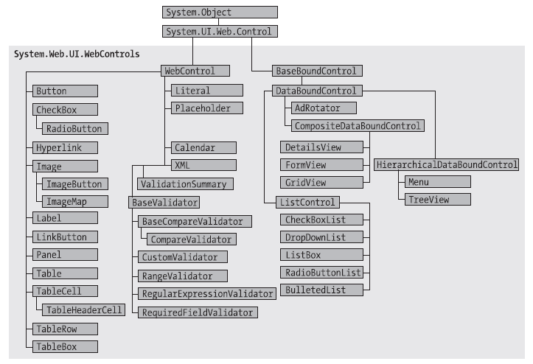
Anadolu University

Slide 12
WebControl Base Class
Property | Description
AccessKey | Specifies the keyboard shortcut key (Supported only in IE4.0+)
BackColor, ForeColor, BorderColor | Specifies the colors
BorderWidth | Size of the control border
BorderStyle | Dashed, Dotted, Double, Groove, Ridge, Inset, Outset, Solid and None
Controls | Provides a collection of controls inside the current control
Enabled | Specifies if the control can receive user input or focus
Anadolu University

Slide 13
WebControl Base Class
Property | Description
EnableViewState | Specifies if the control maintains its state
Font | Specifies the font of the control
Height and Width
Page | Provides a reference to the web page that contains this control
Parent | Provides a reference to the control that contains this control
TabIndex | Provides Tab order (IE4.0+)
ToolTip | Message to be shown when mouse is hovered
Visible | If false, the control is not rendered to browser
Anadolu University

Slide 14
Units
Units should be in pixels (px) or percentage (%)
Example:
  In .aspx file:
    <asp:Panel Height="300px" Width="50%" ID="pnl" runat="server" />
  In .aspx.cs file:
    pnl.Height = Unit.Pixel(300);
    pnl.Width = Unit.Percentage(50);
Anadolu University

Slide 15
Enumerations
Enumerations are used heavily in .NET class library
Makes sure that you select proper value for a property
Visual Studio helps to select enumeration values
Examples:
  In .aspx.cs file:
    ctrl.BorderStyle = BorderStyle.Dashed;
  In .aspx file:
    <asp:Label BorderStyle="Dashed" Text="Border Test" ID="lbl" runat="server" />
Anadolu University

Slide 16
Colors
You can create color objects in several ways:
  Using an ARGB (alpha, red, green, blue) value
  Using a predefined .NET color name
  Using an HTML color name
System.Drawing should be imported
Alpha component represents the transparency of the control (0: Transparent, 255: Opaque) and has no meaning in web pages
Use Color.FromArgb(red, green, blue);
Use color codes with ‘#’ sign like ‘#FF88FF’
Anadolu University

Slide 17
Color Examples
using System.Drawing;
int red = 0, green = 255, blue = 0;
ctrl.ForeColor = Color.FromArgb(red, green, blue);
ctrl.ForeColor = Color.Crimson;
<asp:TextBox ForeColor="#FF50FF" Text="Test” ID="txt" runat="server" />
Anadolu University

Slide 18
Fonts
Property | Description
Name | A string indicating the font name (such as Verdana)
Names | An array of strings with font names, in the order of preference
Size | Size of the font
Bold, Italic, Underline, and Overline | Style attributes
Anadolu University

Slide 19
Font Examples
<asp:TextBox Font-Name="Tahoma" Font-Size="40" Text="Size Test" ID="txt" runat="server" />
<asp:TextBox Font-Names="Verdana,Tahoma,Arial" Text="Size Test" ID="txt" runat="server" />
ctrl.Font.Name = "Verdana";
ctrl.Font.Bold = true;
ctrl.Font.Size = FontUnit.Small;
Anadolu University

Slide 20
Supported Fonts
The following fonts are supported by all browsers:
  Times
  Arial and Helvetica
  Courier
Following fonts are supported by Windows and Mac:
  Verdana
  Georgia
  Tahoma
  Comic Sans
  Arial Black
  Impact
Anadolu University

Slide 21
Control Prefixes
You can use three-letter lowercase prefixes to identify the type of the control easily:
  Button: cmd (or btn)
  CheckBox: chk
  Image: img
  Label: lbl
  List control: lst
  Panel: pnl
  RadioButton: opt
  TextBox: txt (or tb)
Anadolu University

Slide 22
List Controls
ListBox, DropDownList, CheckBoxList, RadioButtonList, and BullettedList are inherited from ListControl base class
Most used properties are:
  ctrl.Selected
  ctrl.SelectedItem
  ctrl.SelectedIndex
  ctrl.Items.Add(“new item to be shown”);
    (ctrl represents the name of the list control)
Anadolu University

Slide 23
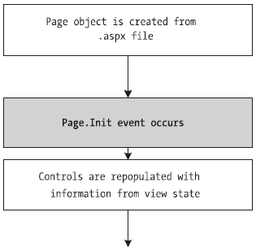
PostBack Processing Sequence
Anadolu University

Slide 24
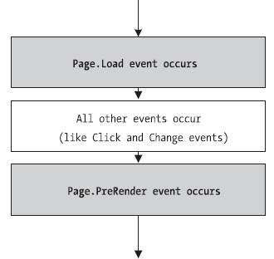
PostBack Processing Sequence
Note that Button_Click event occurs after Page_Load event
Anadolu University

Slide 25
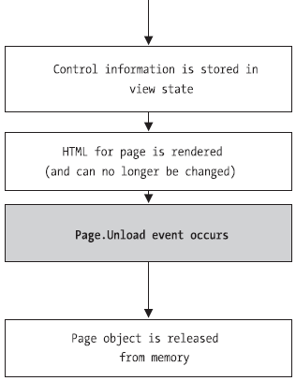
PostBack Processing Sequence
Anadolu University

Slide 26
TextBox
Property | Description
Text
TextMode | SingleLine, MultiLine, Password
ReadOnly
MaxLength | Maximum number of characters that can be entered
Columns | The width of the textbox in characters
Anadolu University

Slide 27
Label
Property | Description
Text
ForeColor | Color of the text
BackColor | Background color
CssClass | CSS class name applied to the label
Anadolu University

Slide 28
Button and LinkButton
Property | Description
Text
OnClientClick | The client-side (JavaScript) code that is executed on a client-side OnClick event
PostBackUrl | The URL to be post (Don’t use this property unless you are sure that you need it!!!)
CommandArgument and CommandName | If more than one buttons are handled with the same button_click event, the button can be separated from the others by these properties
Anadolu University

Slide 29
ImageButton
Property | Description
AlternateText | The alternate text displayed when the image cannot be shown
ImageUrl | The URL of the image to be shown
ImageAlign | The alignment of the image
Anadolu University

Slide 30
HyperLink
Property | Description
Text
NavigateUrl | The URL to navigate to
ImageUrl | Image to be shown as a hyperlink
Target | The target frame (_blank, _parent, _search, _self, _top)
Anadolu University

Slide 31
ListBox
Property | Description
AutoPostBack | Automatically postback to the server after selection is changed
Items | The collection of items in the list
SelectionMode | Single or Multiple (if Multiple, loop through the items in the Items collection and check each item’s Selected property)
Anadolu University

Slide 32
CheckBox
Property | Description
AutoPostBack | Automatically postback to the server after selection is changed
Checked | The boolean variable that shows if the control is checked or not
Text
TextAlign
Anadolu University

Slide 33
DropDownList, CheckBoxList, and RadioButtonList
Property | Description
AutoPostBack | Automatically postback to the server after selection is changed
AppendDataBoundItems | Append data bound items to statically declared list items
Items | The collection of items in the list
SelectedIndex, SelectedItem, SelectedValue | Properties about the selected item in the list
Properties starting with Data… | Properties to be used for data binding
Anadolu University

Slide 34
RadioButtonList and CheckBoxList
Property | Description
RepeatDirection | Vertical or Horizontal
RepeatLayout | Table or Flow
RepeatColumns | The number of columns to use to lay out the items
Anadolu University

Slide 35
ImageMap
When specific areas or points of an image is clicked, that area information can be used for different purposes
For more information, search in MSDN helps
Useful properties:
  ImageUrl
  HotSpot
  HotSpotMode
  ImageMapEventArgs (in ImageMap_Click event)
Anadolu University

Slide 36
BullettedList
Property | Description
BulletStyle | Numbered, LowerAlpha, UpperAlpha, LowerRoman, UpperRoman, Disc, Circle, Square, CustomImage
BulletImageUrl | The URL of an image to use as bullets
FirstBulletNumber
DisplayMode | Text, HyperLink, LinkButton
Anadolu University

Slide 37
HiddenField
HiddenField is used to store the value of a variable invisible to the user
Its most important property is Value (of type string)
Its most important event is ValueChanged event
Anadolu University

Slide 38
Literal
Literal control is used to embed an HTML code directly into the web page
The property Mode determines whether the Text is encoded or not
Anadolu University

Slide 39
FileUpload
FileUpload is used for uploading files to the server
HasFile property is true if a file is sent
File name can be obtained by FileName property
File can be saved by the method SaveAs()
Maximum file size is determined in web.config file
Content length and content type can be obtained from the PostedFile property
Security settings must be set for the directory on the server where the file is saved
Anadolu University

Slide 40
Panel
Acts as a container for other web controls
Put controls in several panels and set Visibility properties of each panel to show or hide the controls in them
Anadolu University

Slide 41
Sending User to a New Page
In a typical website, the user will need to surf from one page to another to perform different tasks
The following four methods can be used for sending user to a new page:
  Use an ordinary <a> anchor element:
    Click <a href="newpage.aspx">here</a> to go to new page.
  Use the HyperLink web control:
    <asp:HyperLink ID="HyperLink1" runat="server" NavigateUrl="http://www.anadolu.edu.tr/">Anadolu University</asp:HyperLink>
Anadolu University

Slide 42
Sending User to a New Page (continued)
  Use Response.Redirect method:
    Response.Redirect("newpage.aspx");
  Use Server.Transfer method:
    Server.Transfer("newpage.aspx");
    User’s browser shows the original URL
    Don’t use this method until you become an expert or you’re sure that you need it!!!
Anadolu University

Slide 43
The Anatomy of ASP.NET Pages
Windows applications are composed of single EXE file
ASP.NET applications can the thought as separate programs
Every pages in an ASP.NET application shares the same resources
An ASP.NET application can’t share another application’s resources, even both are in the same web server
Every ASP.NET application is executed inside a separate application domain
Anadolu University

Slide 44
Application Domain
Application domains are isolated areas in memory
Ensures that if an application causes a fatal error, other applications in the same computer are not affected
Ensures that each web application has its own set of cached, application and session data
Each web application are invoked from a virtual directory
ASP.NET applications are deployed in a virtual directory
Anadolu University

Slide 45
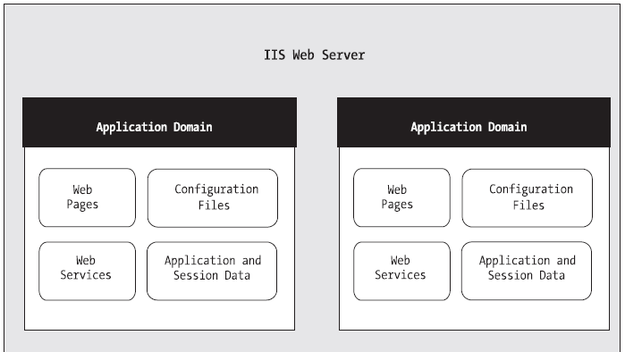
Application Domain
Anadolu University

Slide 46
ASP.NET File Types
File Name | Description
.aspx | Standard ASP.NET web pages
.ascx | ASP.NET user controls
.asmx | ASP.NET web services
web.config | XML-based configuration file
Global.asax | Global application file
.cs | Code-behind files that contain C# codes
Anadolu University

Slide 47
ASP.NET Directories
Directory | Description
Bin | Contains all the compiled .NET components (DLLs)
App_Code | Contains source code files
App_GlobalResources | Contains global resource files that can be used by all web pages in the application
App_LocalResources | Same as above but each file is used by only one web page
App_WebReferences | Stores references to web services
App_Data | Stores database files
App_Themes | Stores the themes
Anadolu University

Slide 48
ViewState
When a web page is displayed in a browser, a hidden field named “__VIEWSTATE” can be seen by looking at the source
This field stores information, in compressed format, about the state of every control in the page
This is necessary because the web server doesn’t know the current state of each request
Using ViewState, the web server decides whether the value of a control is changed or not, and fires the required events
Anadolu University

Slide 49
HTML Encoding
Some certain characters have special meaning in HTML, e.g. ‘<’ and ‘>’
If you display them in the web page, you should convert them to equivalent HTML codes, e.g. ‘&lt;’ and ‘&gt;’
Or you can use Server.HtmlEncode() method:
  Ctrl.InnerHtml = Server.HtmlEncode("Click <here>");
HtmlDecode(), UrlEncode() and UrlDecode() are other useful methods in Server object
Anadolu University

Slide 50
Application Events
You can handle application-specific events using Global.asax file
Global.asax file can be added to the project by Add New Item… command
Example: You can count the number of connected users by using Session_Start() and Session_End() methods
Example: You can redirect to an error page if an error occurs using Application_Error() method
Anadolu University

Slide 51
Application Events
Method | Description
Application_Start() | Occurs when the application starts, i.e., when the first user requests a web page
Application_End() | Occurs when the application is shutting down
Application_BeginRequest() | Occurs with each request, just before the page is executed
Application_EndRequest() | Occurs with each request, just after the page is executed
Anadolu University

Slide 52
Application Events
Method | Description
Session_Start() | Occurs whenever a new user request is received and a session is started
Session_End() | Occurs when a session times out or is programmatically ended
Application_Error() | Occurs in response to an unhandled error
Anadolu University

Slide 53
ASP.NET Configuration
Every web application stores its configuration settings in web.config file
web.config file uses a predefined XML format
The three most important sections are
  <appSettings> </appSettings>
  <connectionStrings> </connectionStrings>
  <system.web> </system.web>
web.config file is not served by IIS
web.config file can be configured by Website Administration Tool (WAT)
Anadolu University

Slide 54
Storing and Using Custom Settings
<appSettings>
<add key="DataFilePath"
value="e:\NetworkShare\Documents\WebApp\Shared" />
</appSettings>
lblTest.Text = WebConfigurationManager.AppSettings["DataFilePath"];
Anadolu University

Slide 55
References
Beginning ASP.NET 3.5 in C# 2008: From Novice to Professional
MSDN Help
Anadolu University

